Slide 1
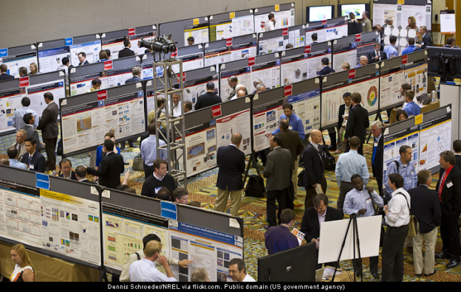
Academic Poster presentations
What? Why? Who?
First steps – grabbing attention
How to design an effective poster
How to design a good looking poster
How to present at a poster session
+ Tips on what to do
+ Tips on what NOT to do
Anna L. Garden
Department of Chemistry
University of Otago, Dunedin, New Zealand MacDiarmid Institute for Advanced Materials and Nanotechnology

Slide 2
Who are you and why are you here?
What? Why? Who?
First steps – grabbing attention
How to design an effective poster
How to design a good looking poster
How to present at a poster session
+ Tips on what to do
+ Tips on what NOT to do

Slide 3
What is a poster session?
Most academic conferences have a series of talks but also have 1+ poster session.
Usually lasts for 1-2 hours
Presenters have poster of their work displayed.
Presenters stand with their posters while other delegates browse.
Can be hundreds of posters!
Posters need to catch the eye, convey information efficiently and presenters want to get the most out of face-to-face interactions.

Slide 4
Why are you there? (Know your purpose)
There are a number of reasons to present a poster at a conference.
Share your work with the wider community (obvious!)
Promote a paper
Discuss preliminary results
Meet potential supervisors
Meet potential collaborators
Before you start to design your poster, think about what you want to get out of this communication.

Slide 5
What type of conference? (Know your audience)
Our group’s research interests are in using computational methods for understanding and designing (nanoscale) catalysts for sustainable industry and environmental remediation.
We can (and have) presented our research at a range of conferences:
Electrocatalysis
Catalysis
Nanocluster structure
Computational chemistry
Physical chemistry
Engineering
General chemistry
The type of conference should guide you to decide:
What project to present
What story to tell
What background is needed
What details to include
How to speak to people at the session

Slide 6
Attention seeking
What? Why? Who?
First steps – grabbing attention
How to design an effective poster
How to design a good looking poster
How to present at a poster session
+ Tips on what to do
+ Tips on what NOT to do

Slide 7
Which poster would you stop at?
During the posters session, delegates often wander (somewhat haphazardly often) before deciding on which poster to inspect more closely. Therefore your poster needs to catch the eye.
You will see 10 posters for 10 seconds each.
Which would you stop at first?

Slide 8


Slide 9


Slide 10
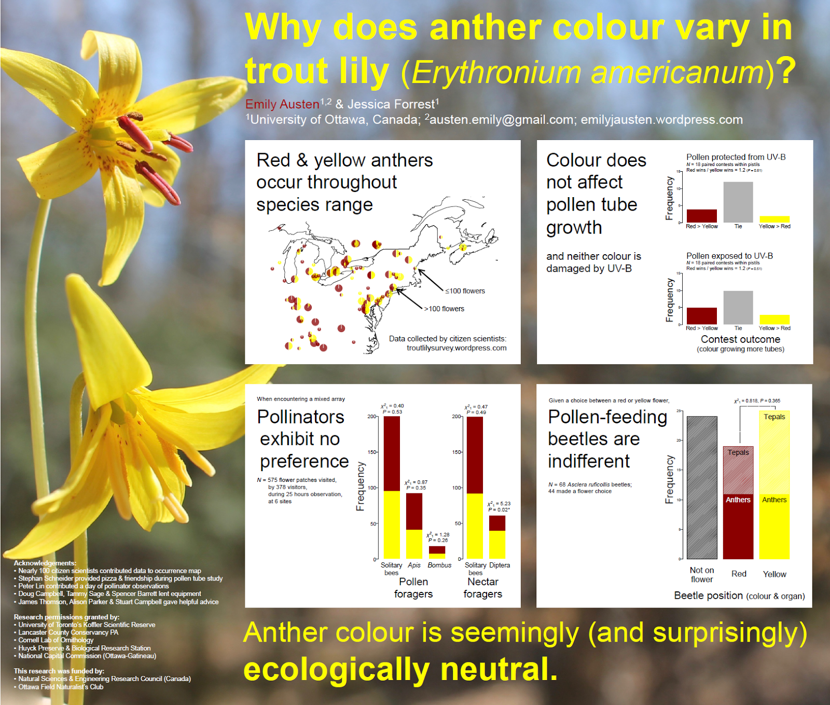

Slide 11
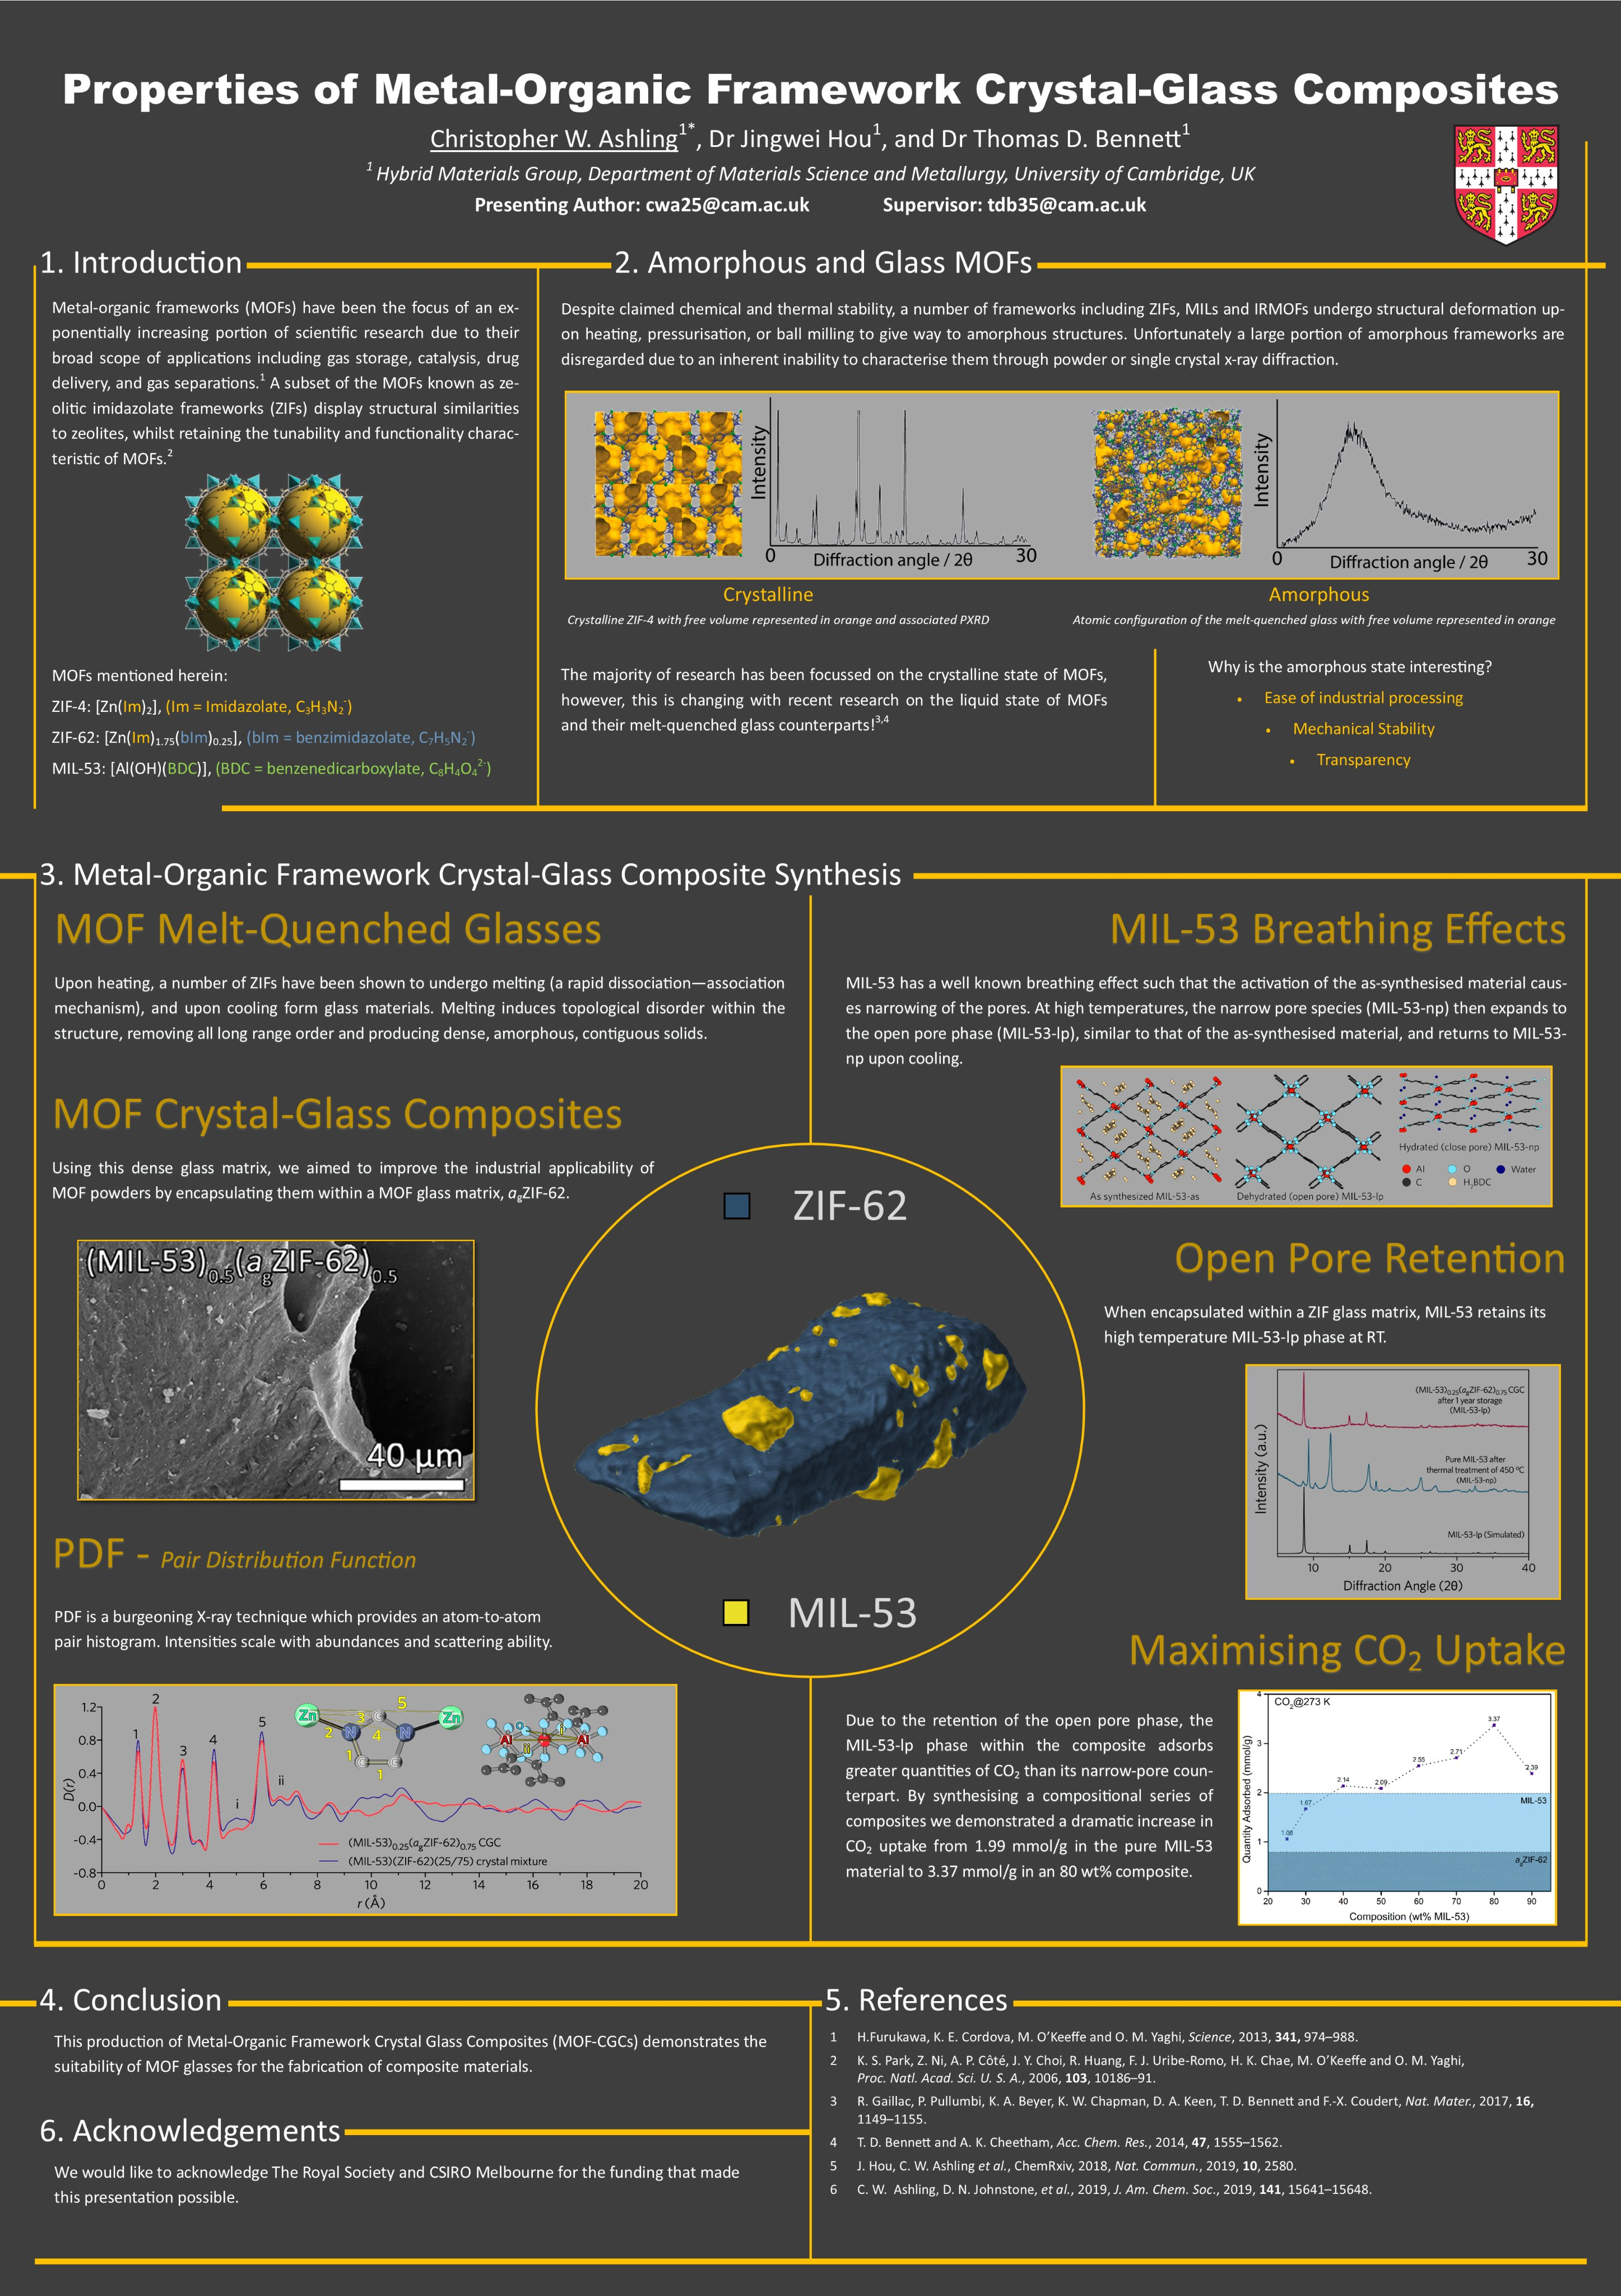

Slide 12
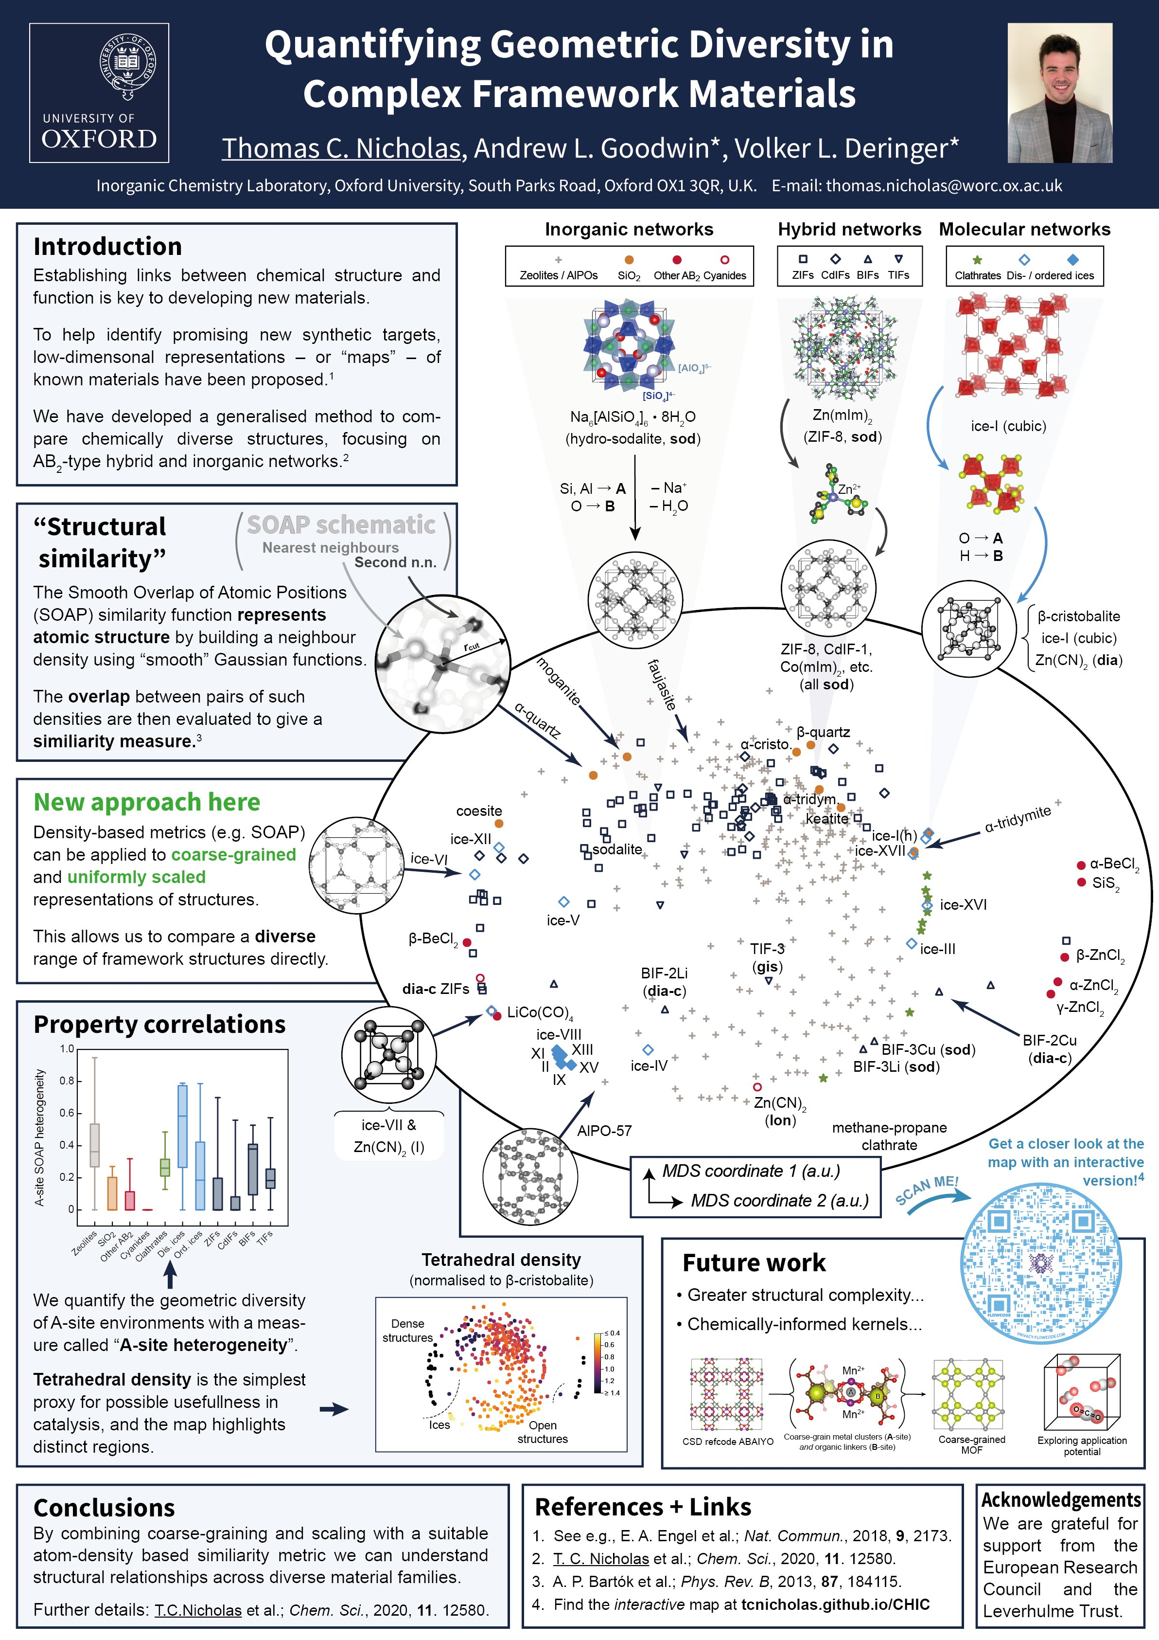

Slide 13
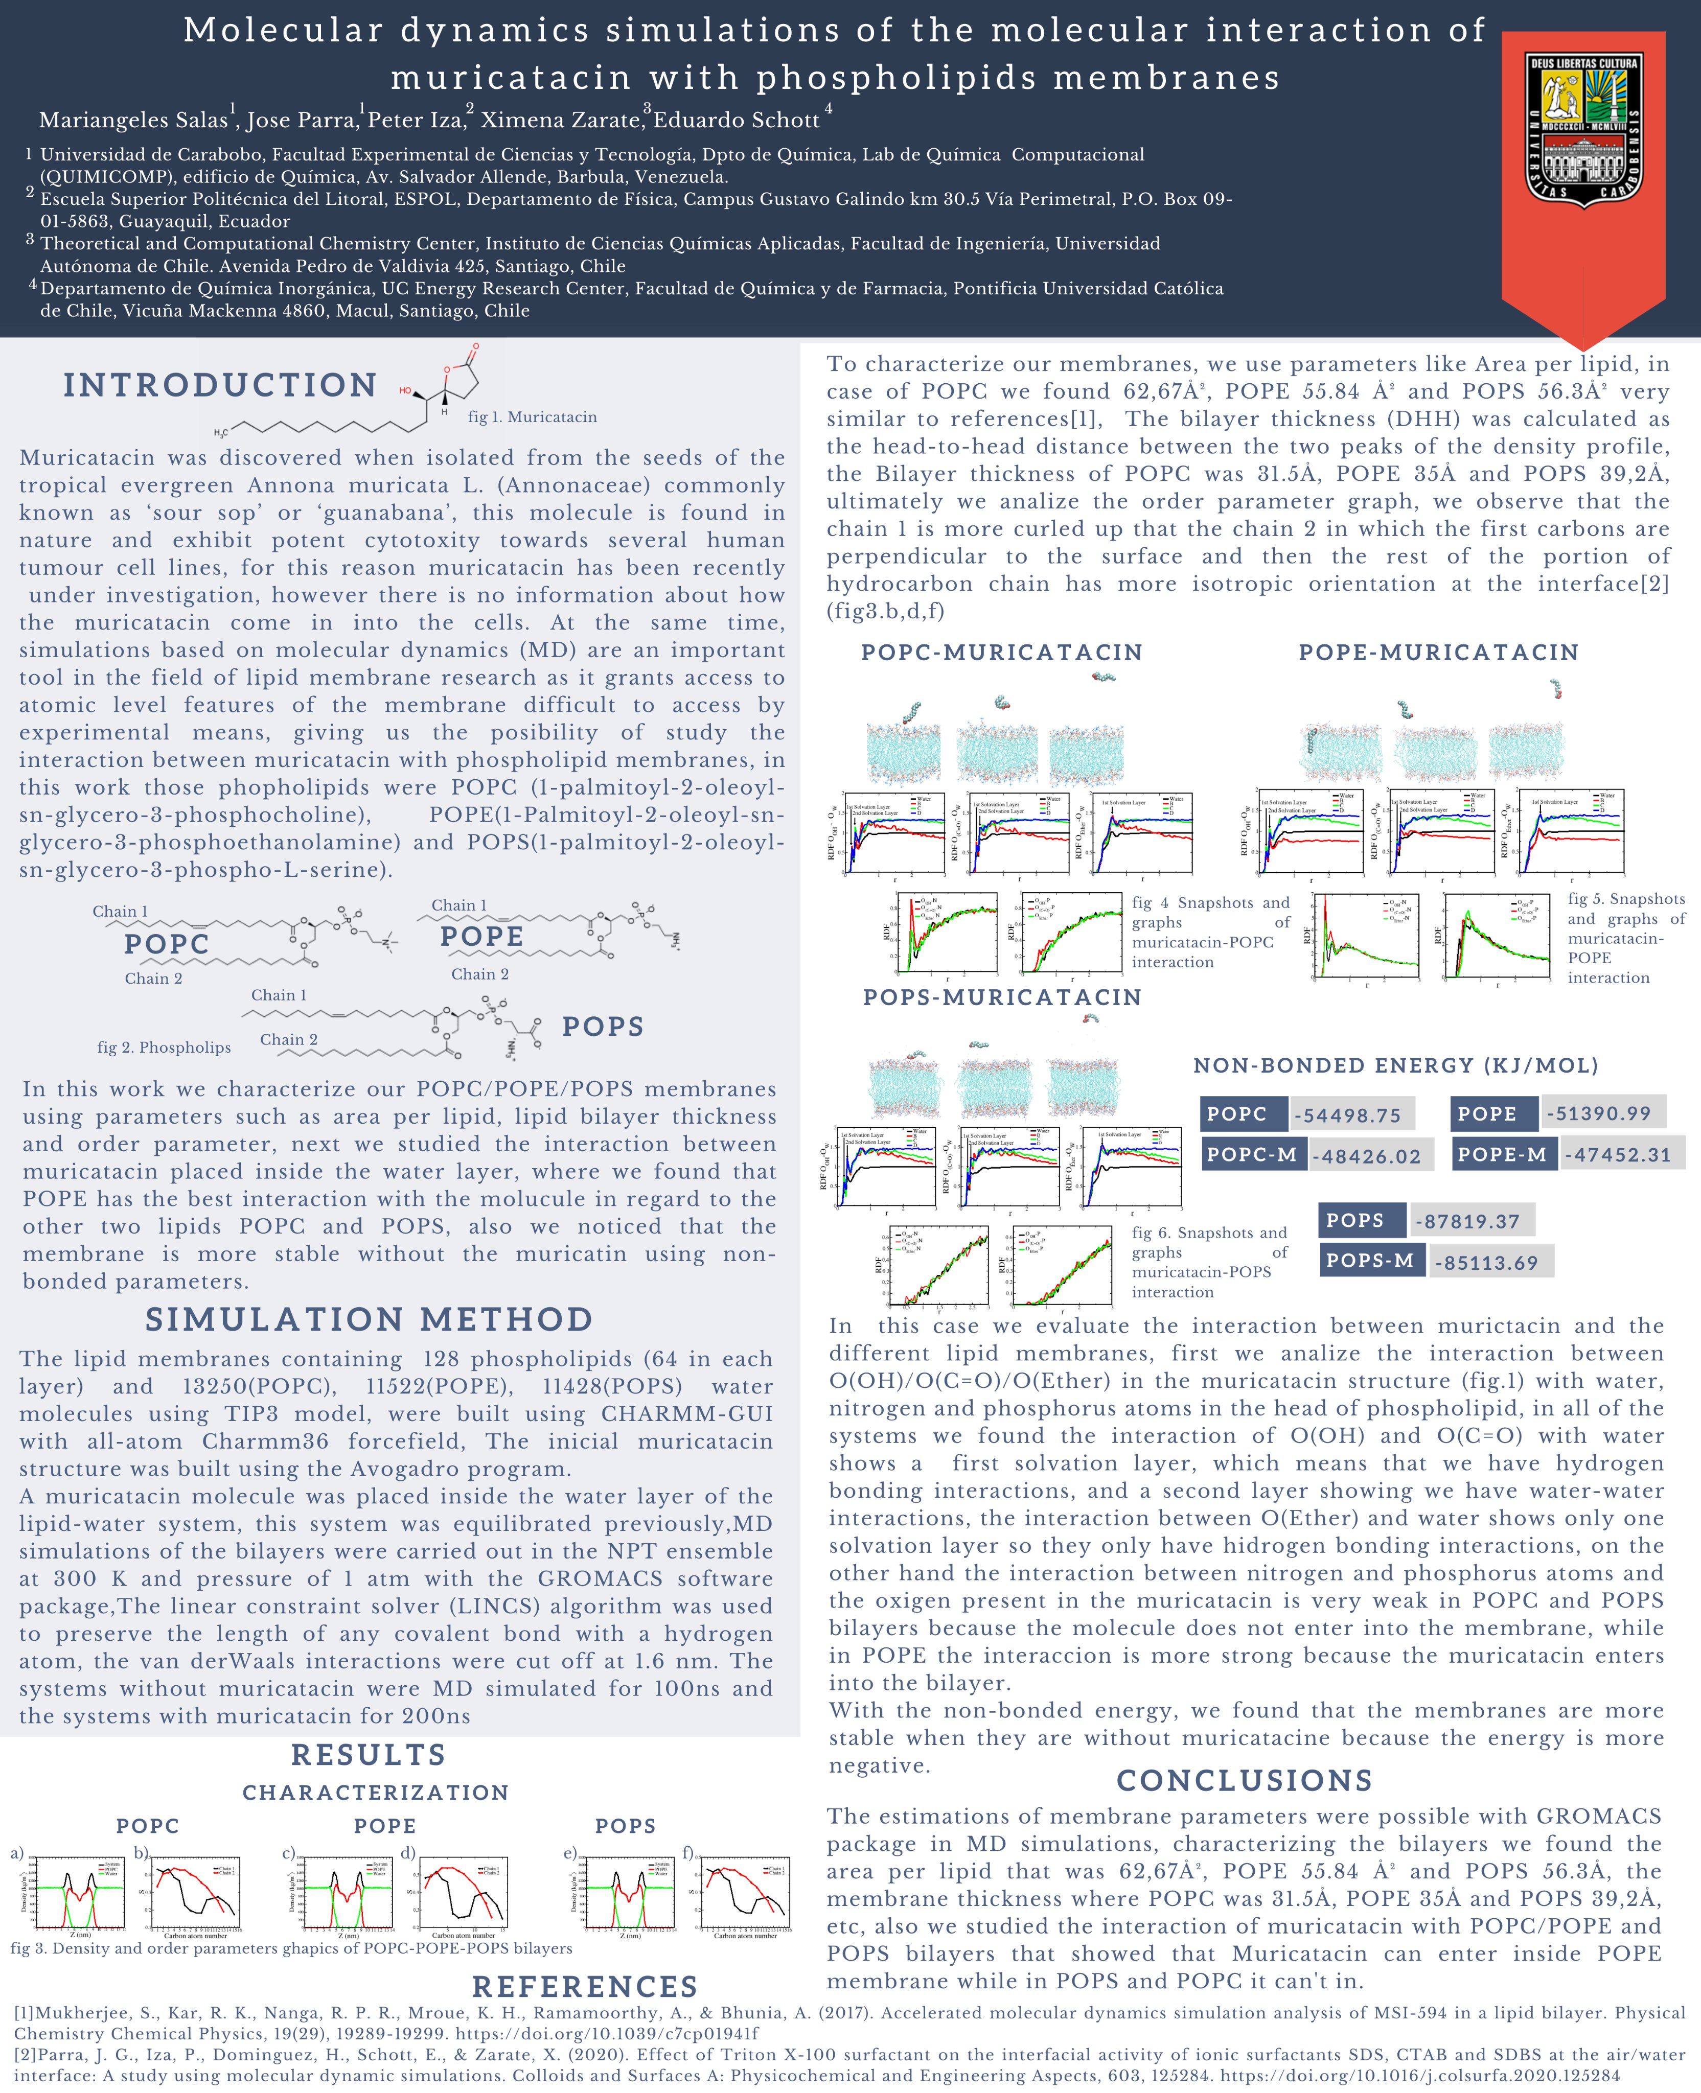

Slide 14
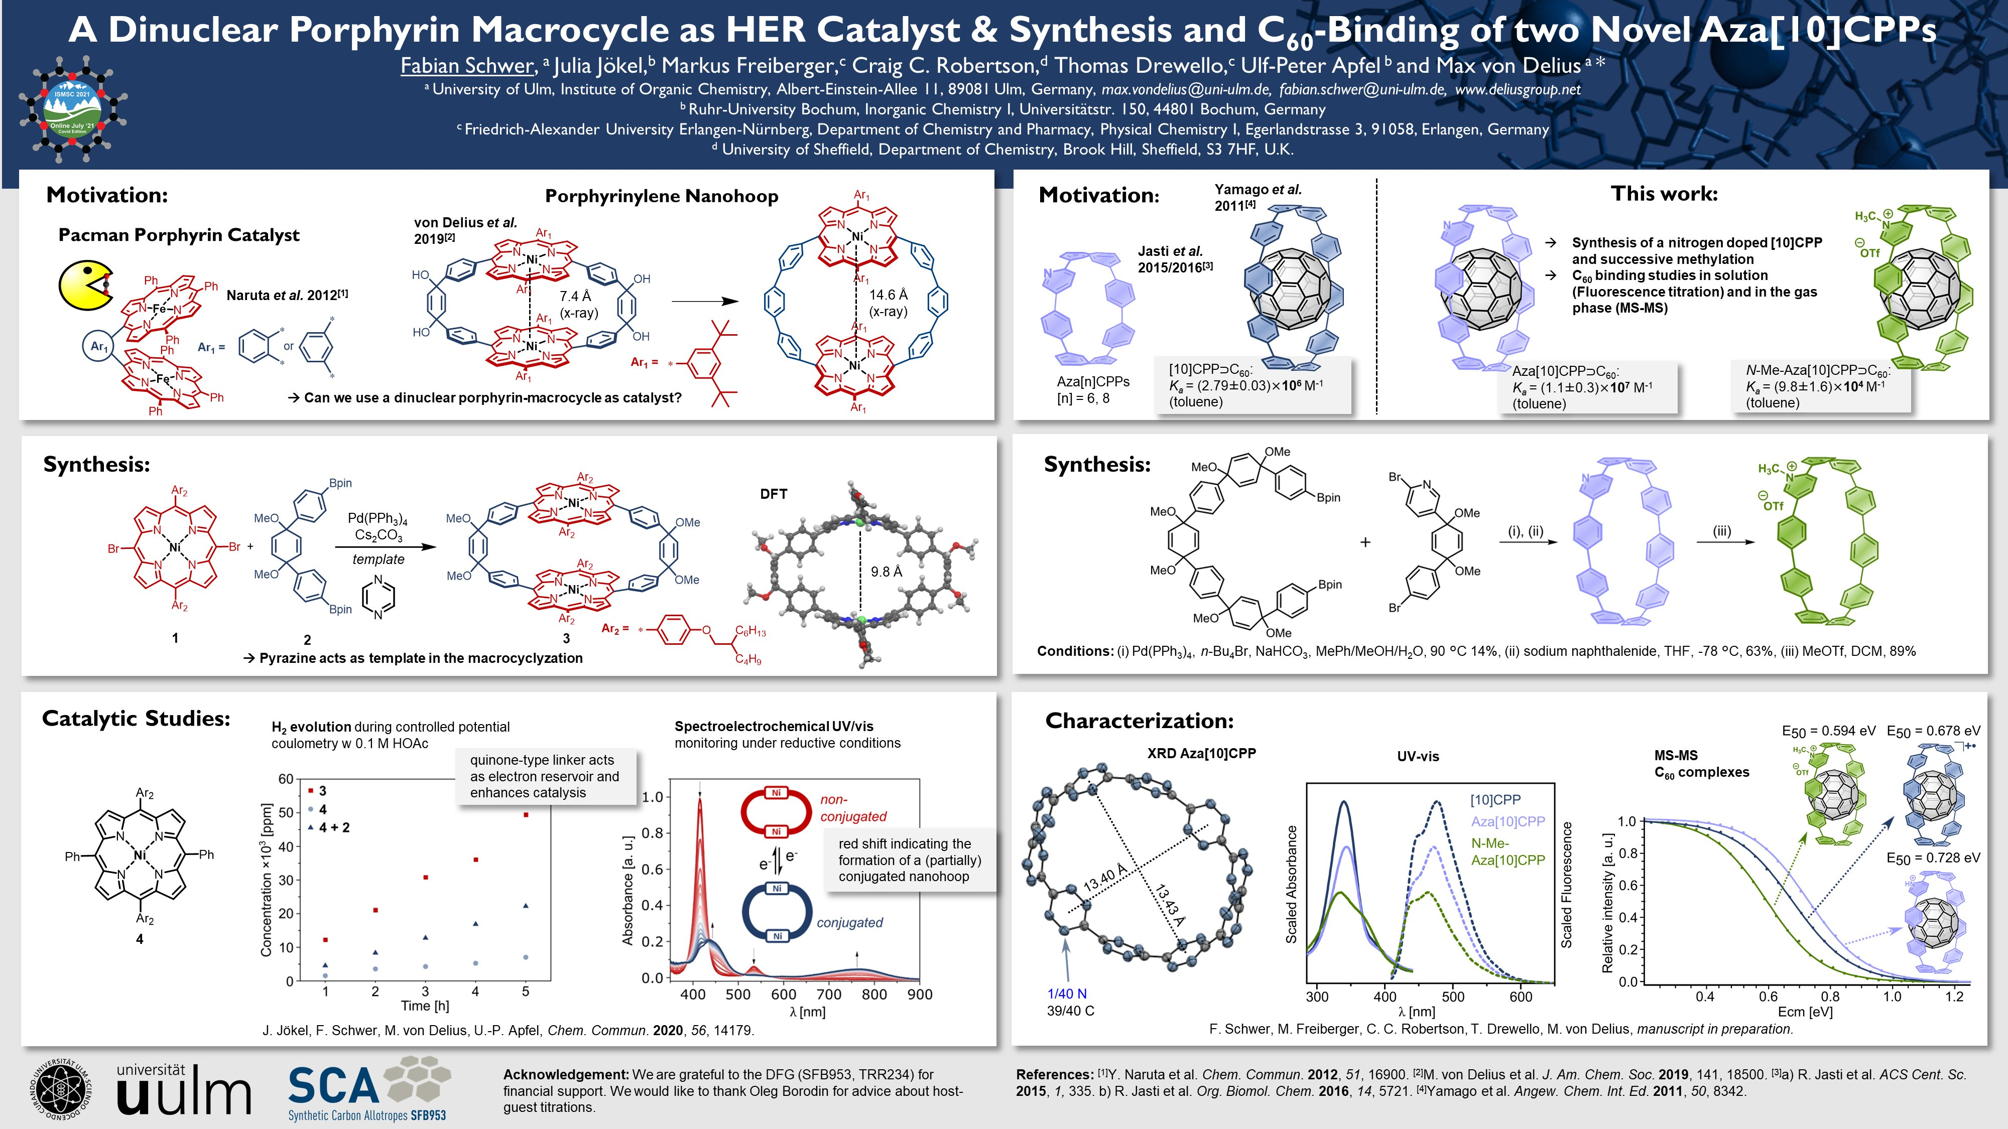

Slide 15
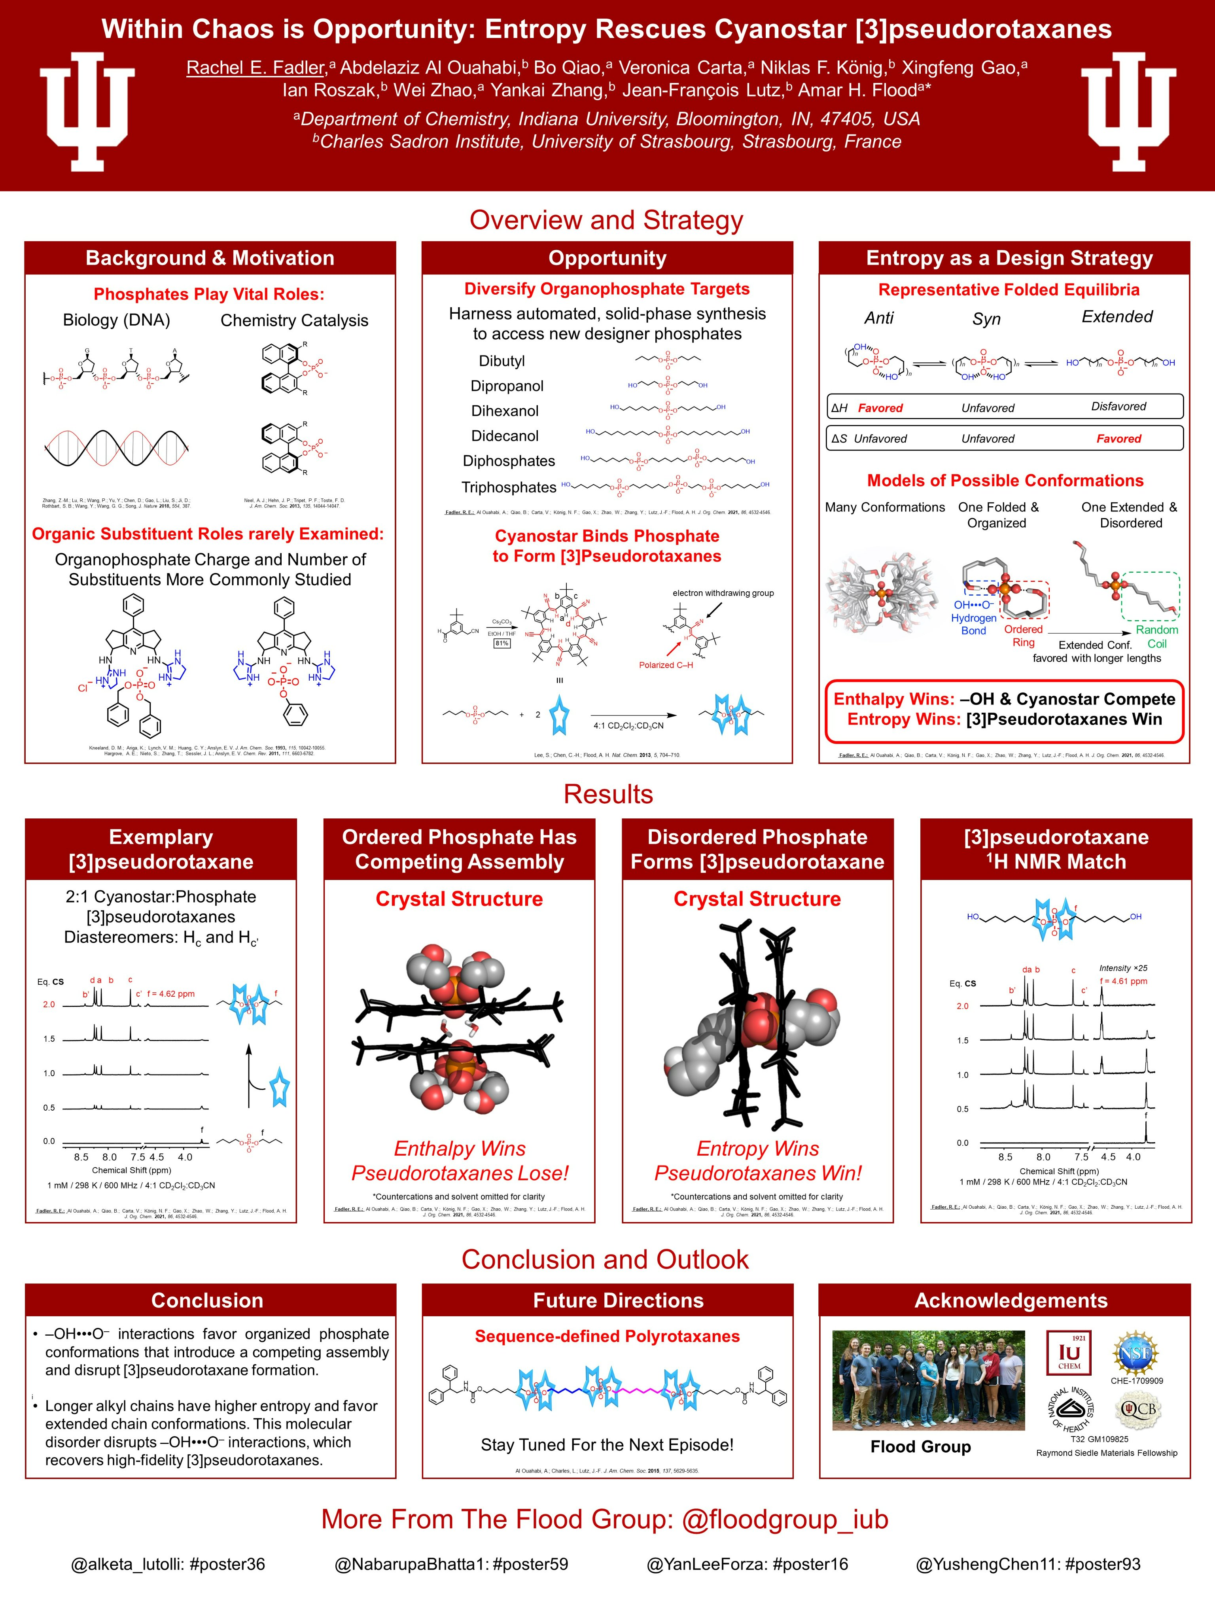

Slide 16
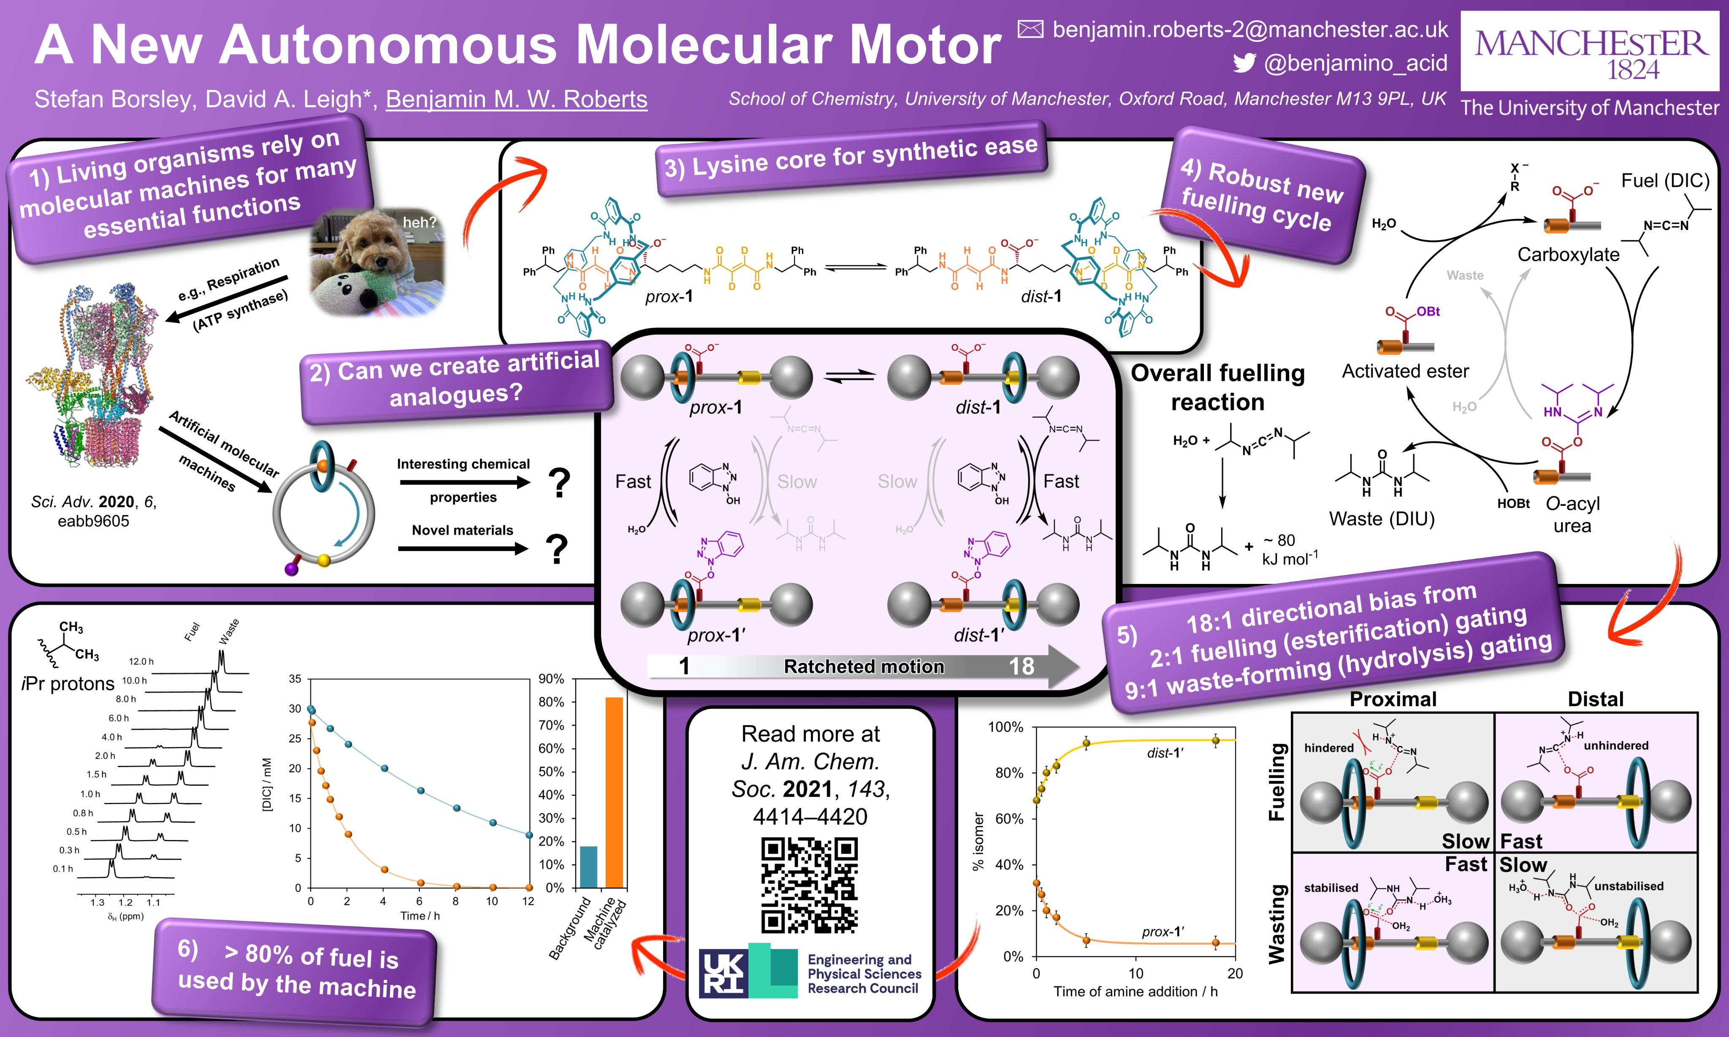

Slide 17
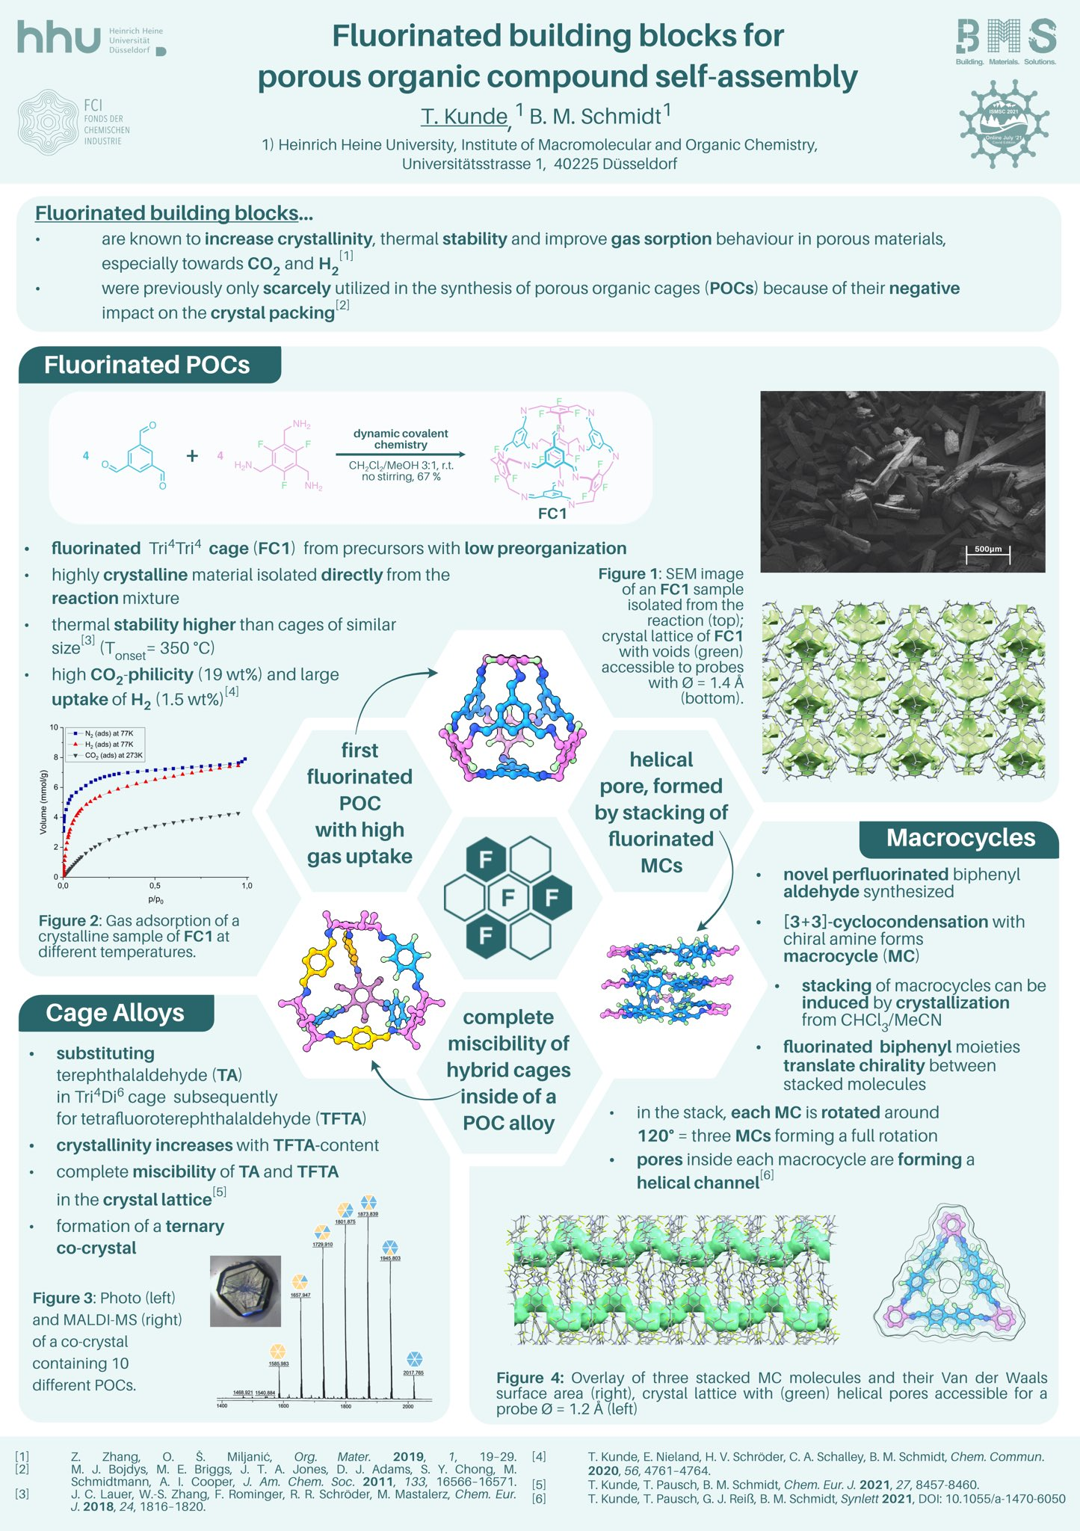

Slide 18
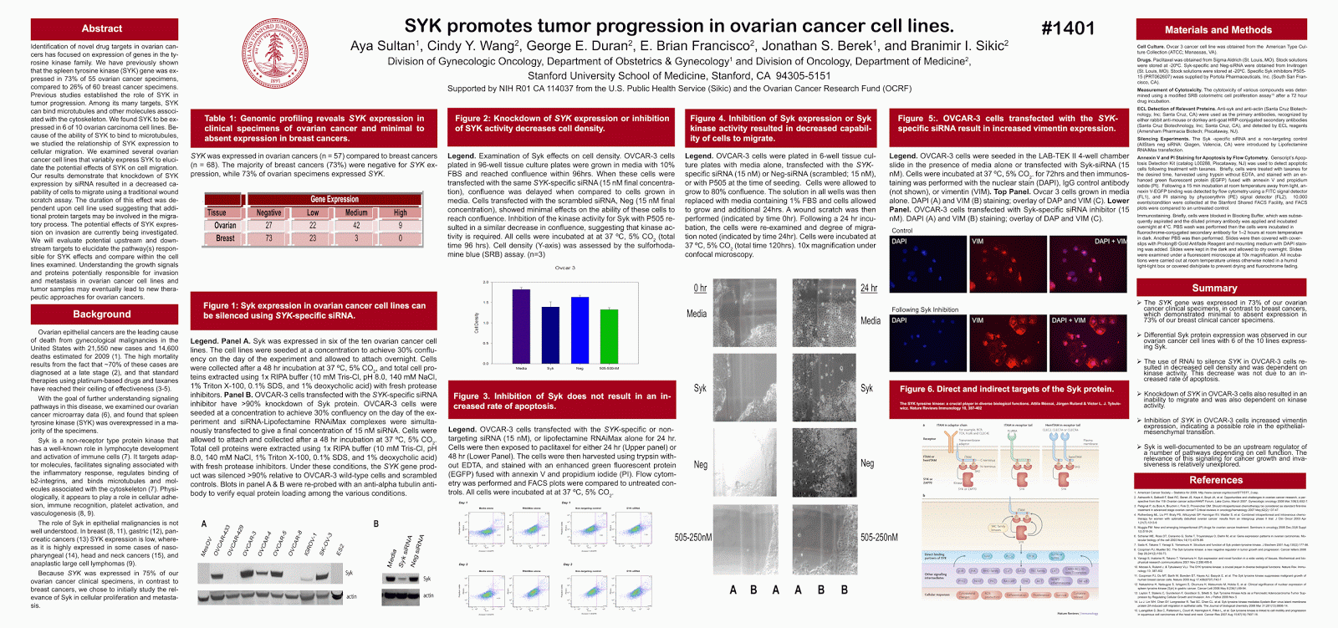

Slide 19
Which poster would you stop at?
During the posters session, delegates often wander (somewhat haphazardly often) before deciding on which poster to inspect more closely. Therefore your poster needs to catch the eye.
You will see 10 posters for 10 seconds each.
Which would you stop at first?
Are there any that grabbed you?
Are then any that immediately turned you away from them?
You need to make yours stand out!

Slide 20
Goal of a poster: Effectively communicating
What? Why? Who?
First steps – grabbing attention
How to design an effective poster
How to design a good looking poster
How to present at a poster session
+ Tips on what to do
+ Tips on what NOT to do

Slide 21

Story and Structure
What is your story?
Posters are NOT just an academic paper enlarged to A0 (or A1 – check!).
They should be focused – tell one thing very clearly.
To do this you need to have both narrative and visual structure.
Do your ideas flow from one thing to the next to build up the story?
Is it obvious how to make your way around the poster?

Slide 22

Sketch out your story first
Grab a pen and paper and start throwing ideas around.
Which project will you present on?
What are the most interesting things in this project?
What different stories can be told from the interesting parts of your project?
Pick one and don’t try to shoe-horn other things in!
With your story defined, think again about your audience
What kind of background do they need?
What kinds of details will they be interested in?

Slide 23

Example
Aims of the paper? Investigate CuPd cluster structure/segregation as a function of composition
Develop and benchmark theoretical methodology
Probably cannot cover both of these. Try and write down one research question to answer, e.g.
What is the structure and segregation of 38-atom bimetallic CuPd clusters?
What is required for accurate description of CuPd cluster structure?
Consider putting the research Q prominently on your poster

Slide 24
Building up the story
Starting from your research question, where does the story go?
Sometimes easiest to start from the end. What is your main conclusion and what do you need to tell to get to this point?
Finally, motivate the research question briefly.
What is this important?
Background/motivation can usually be done much more succinctly than you think.

Slide 25
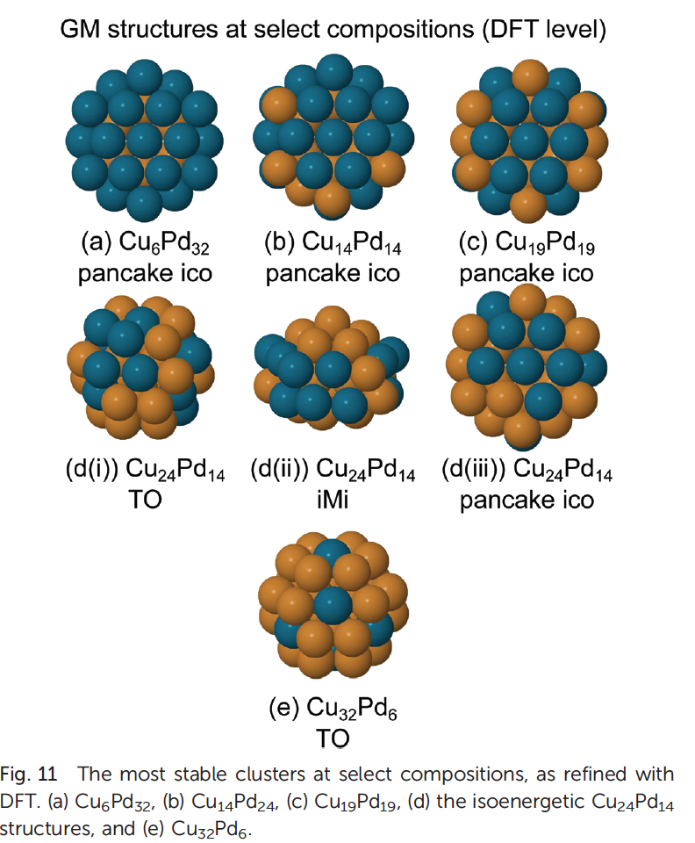
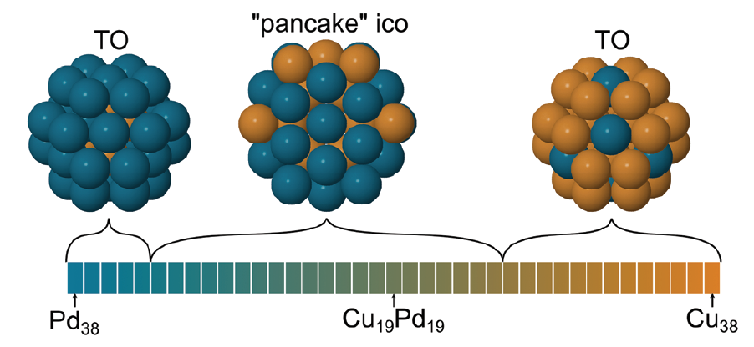
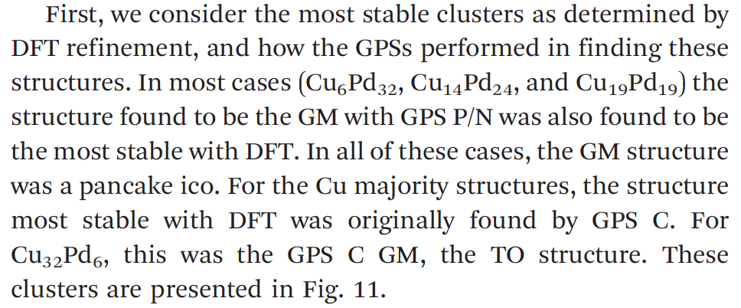
How to convey your points?
With your story built up, think about how to convey your points.
Can you do it with a figure? Visually is best.
A figure that you use on a poster may not necessarily be the same as a figure in a paper:
better for a poster?
paper

Slide 26
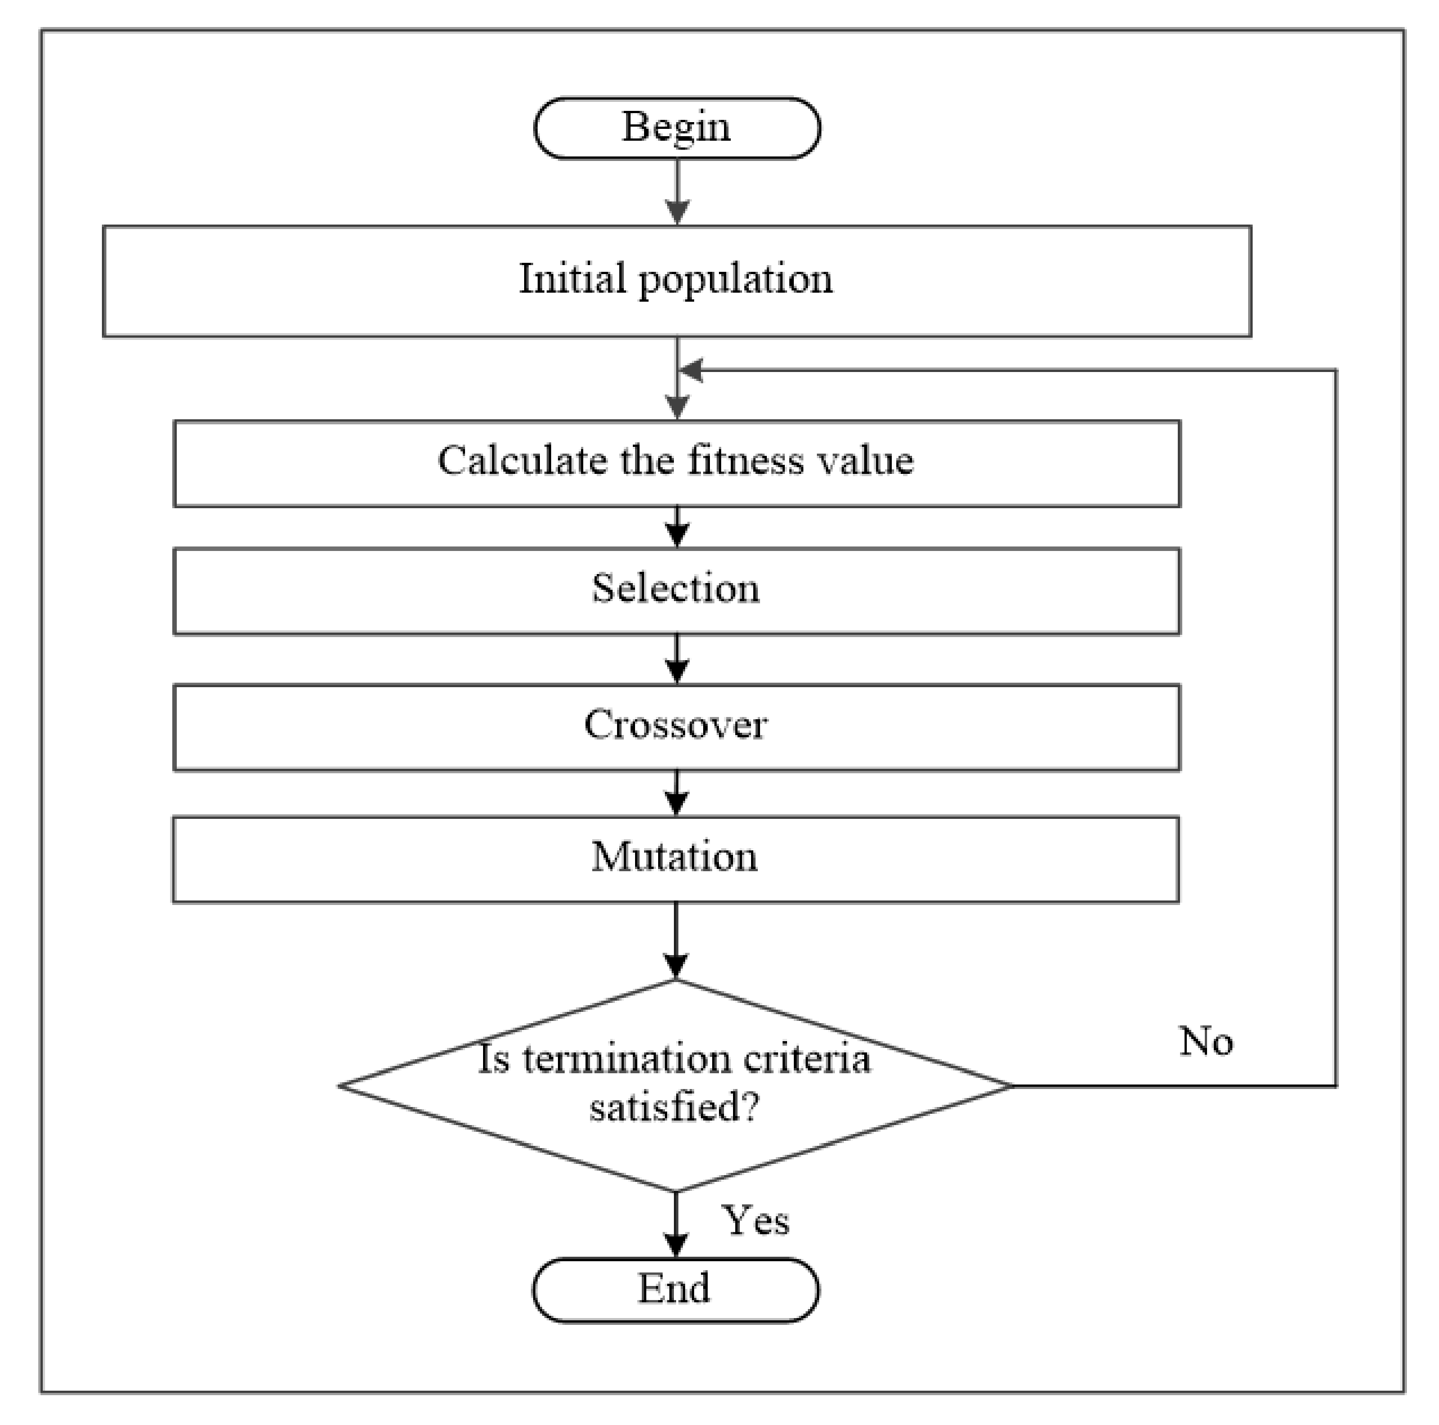
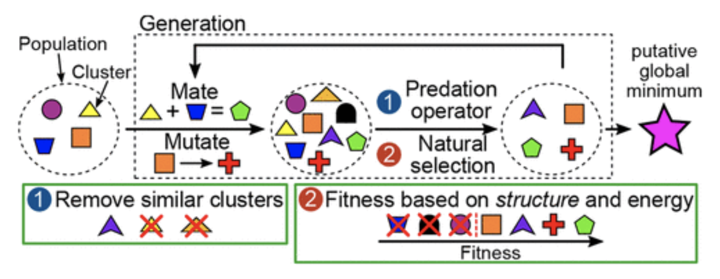
Schematics can be really useful
You can use schematics to either reduce the number of words, or make methods/results visually appealing:

Slide 27
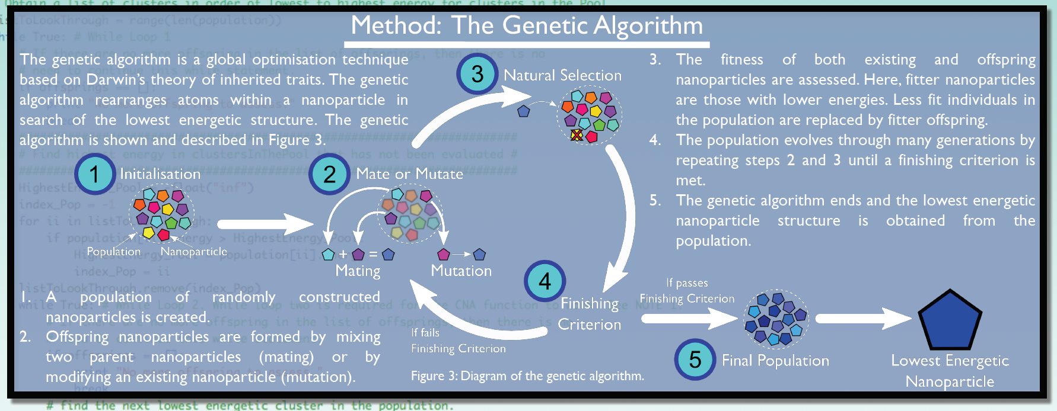
Schematics can be really useful
You can also play with the set-up of your schematic once the poster design gets a bit more finalized to use space well:

Slide 28
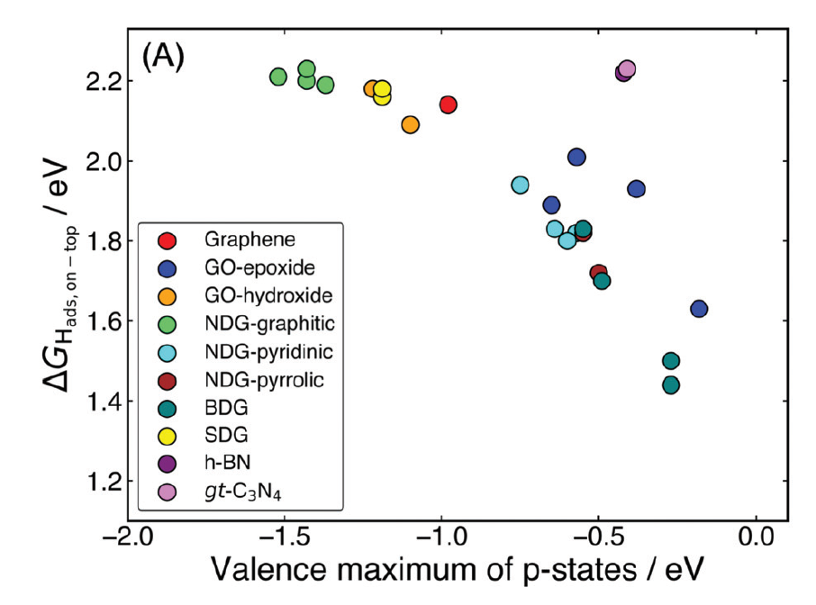
The fewer words the better
Posters are visual presentations. You cannot do everything with figures so there will necessarily be words involved somewhere. To reduce the words consider:
bullets/phrases
graphics (again)
labels/text on graphics instead of captions
legends inside figures

Slide 29
Methodology
You do not need to give all details of methodology used. It is not a paper.
This section is likely highly dependent on your audience.
Highlight key aspects of methodology, in particular novel techniques or techniques that uniquely allowed you to reach your conclusions.
Sometimes methodology doesn’t need mentioned – if you show an NMR spectrum, the audience will know you used NMR!.

Slide 30
Placement of story on the poster
With a good narrative and great figures/bullets, think about how to arrange it – we need to know where to go!
Can use traditional headings (intro, methods etc) – easy to follow.
Can use more meaningful headings but need to be more careful of placement – more interesting but more difficult.

Slide 31
Activity time!
Individually or in pairs groups, design a poster based on your research!
As we haven’t learned about how to make the poster “pretty” yet, we are doing this with pen and paper.
Pick a type of conference
What is your story?
What types of figs/graphics could you design?
How might you lay it out?
What text is necessary?
Use a small piece of paper to brainstorm some ideas then transfer to your “poster”.

Slide 32
Good design can please or irk….
What? Why? Who?
First steps – grabbing attention
How to design an effective poster
How to design a good looking poster
How to present at a poster session
+ Tips on what to do
+ Tips on what NOT to do

Slide 33
The finer details
While ultimately the most important thing about your poster is the overall design and narrative, the details matter.
e.g. Striking colours can help, slopping formatting can be an instant turn off.
We won’t spend too much time on this because there are many, many style guidelines available on the internet, in books etc.
We will instead highlight some points and talk about some decisions/options that are often personal preference, choice.

Slide 34
Size matters
Firstly, figure out what size/layout poster you are allowed by the conference guidelines.
e.g. A0, A1, landscape, portrait
Your typical delegate will usually stand about 2 m from your poster – it must be readable from that distance.
A useful guideline is that if you print your poster on an A4 sheet of paper, you should be able to read it from arms length (saves money from printing big drafts!).
If in doubt, make everything larger. This also makes you poster more accessible to those of poor eyesight (who definitely appreciate the effort!).

Slide 35
Colour Schemes
A colour scheme can make your poster look slick. This can apply to background, fonts etc but also to elements of plots:
Muted, neutral colours are best – avoid garish, bright colours.
Themed backgrounds can work but make sure they are not too distracting.
Consider accessibility again – check your colours for colour-blindness.

Slide 36

Fonts
Keep fonts simple and easy to read. Use no more than two fonts in the entire poster, including figures. This will often mean you need to redraw figures if taken from a thesis etc.
Check fonts with numbers too, before deciding (e.g. this font I am using now is awful for numbers! 0123456789
Do not use: Comic sans
ALL CAPITALS

Slide 37
Acknowledgements and references
These can be small unless you want the reader to be directed to a paper of the same work to get a fuller story of the research.
Consider a QR code or similar.

Slide 38
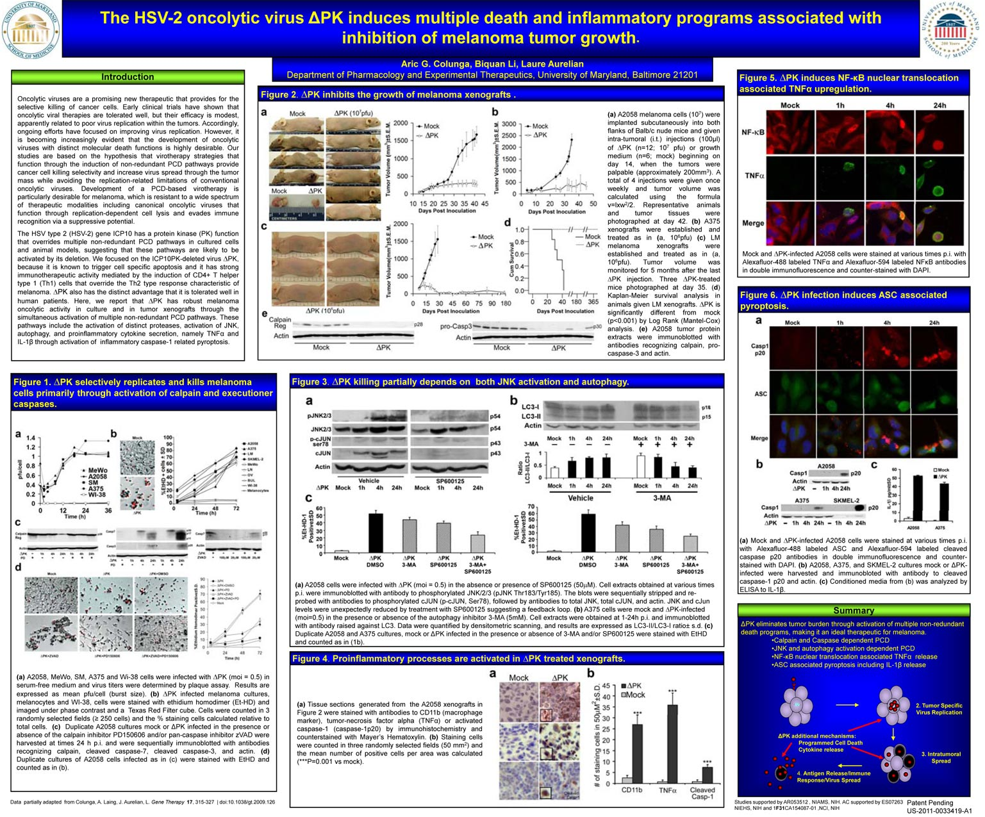
Alignment and columns
Be very careful with alignment. Even slight misalignments when printed large are very distracting.
Use guides and grids to help you.
Column widths need to be chosen carefully. Either even or obviously uneven.

Slide 39
White space is actually helpful
Just because you have a lot of space, doesn’t mean you need to read it.
White space makes your poster look easier to understand and so draws the reader.

Slide 40
A local example

Slide 41
Contentious points?
There are some elements of a poster that people love or hate. Let’s talk about some of them. What might be the pros/cons?
Photo of your institute
Institute logo
Photo of you
Gimmicky title vs long academic title
Memes or cartoons?
There is no right answer of many of these. Do what suits you best.

Slide 42
Use style guides and Get some feedback
Show you poster design to your peers to get honest feedback on colour/font etc. Non-experts can be really helpful.
Use guides that can be found on the internet about what fonts/colours work well.
Browse as many posters as you can for inspiration. Twitter is really useful for this at the moment. If time at the end, you can have a browse through some posters to get ideas.

Slide 43
The poster session
What? Why? Who?
First steps – grabbing attention
How to design an effective poster
How to design a good looking poster
How to present at a poster session
+ Tips on what to do
+ Tips on what NOT to do

Slide 44
What happens at a poster session?
You stand (awkwardly) beside your poster, while others browse the rows of posters.
The goal of the session is to interact with the delegates and explain your poster.
A poster session is sort of a half-way between a talk and a paper.
Use your graphics to illustrate points
Expand verbally as needed

Slide 45
How to engage someone
One of the most awkward parts of poster sessions is deciding when to speak to someone lingering in front of your poster and when to just leave them alone to look at the poster.
Try not to fish hook anyone just wandering past and perhaps try just introducing yourself, letting them have a wee look and say that you’re happy to discuss your work with them further if they’d like.
Any other ideas on good openers?

Slide 46
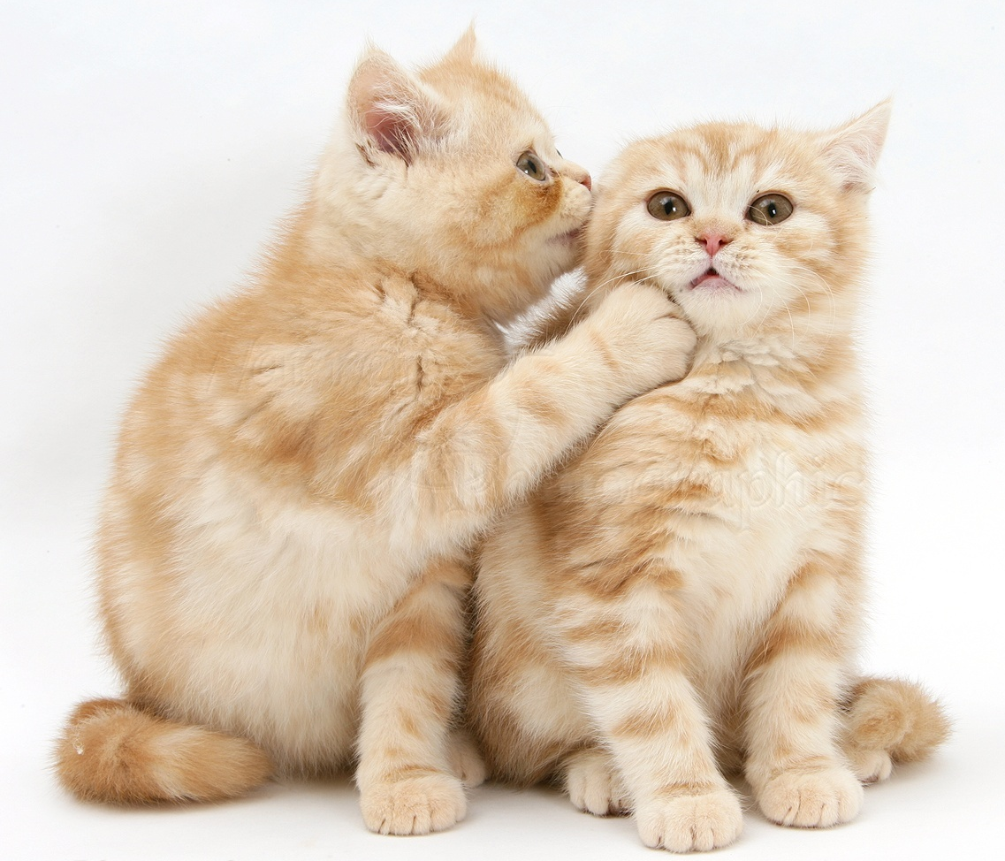
Know your audience
You don’t want to waste anyone’s time:
You don’t want to waste heaps of time with an expert, explaining a lot of basics
You don’t want to be too technical for a non-expert, as they won’t understand.
If you don’t know your audience’s field, ask them what they do! The poster presentation should be a dialogue, not a monologue.

Slide 47
You don’t need a pitch if you have a good story
A common approach is for delegates to ask presenters “Would you like to tell me about your poster?”
This gives you an open slate to walk them through your story. It needn’t be a pitch, as such, but it does need to be brief. I would err on the side of being as brief as possible, which then leaves them to ask questions if they are interested. 1-2 min max.
Start your story with your motivation, what was the question your were trying to solve and wrap back around to this at the end. Don’t just point to and list results and methods.
Point out things that were surprising or you are still confused about – they might have some insight that is helpful!

Slide 48
Common questions that people ask at poster sessions
“Would you like to tell me about your poster?”
What else?

Slide 49
What not to do at a poster session?
Don’t leave your poster. It is annoying if people want to speak to you.
Don’t have your friends crowding your poster. If they want to come and support you, that is great, but they can do that quickly, one-on-one.
Don’t get drunk! Poster sessions often have free beer/wine. Be careful.
Don’t dominate your audience’s time.
Don’t be afraid to talk to the poster presenters around you. It is much less awkward than standing alone and you might learn something/meet someone new.
If you have business cards or copies of your paper, don’t force them onto people, just say they are welcome to take one if they wish.
Don’t ask questions to prove your intelligence.
Don’t forget your poster – so easy to do!

Slide 50
Activity time!
With your sketched out poster from earlier, let’s try and present it to each other.
This is also good practice for asking insightful questions.

